Slide 1
ABS 38W Female Connector Assy

Slide 2
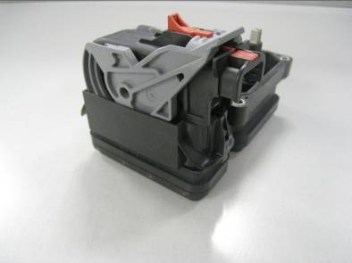
ABS 38W Female connector
Technology Advantage
Standard interface with header
High density circuits application
High performance terminal system
Simplified MFG and assembly process
Alternative wire harness outlet direction
Low operation force with Level lock
Cost savings
Availability
Available for VW group , Ford , HYUNDAI
Application
Sealed type;
IP 67
Temperature range:
-40℃~105℃
Current range:
Terminal 1.5 F, 19A Max
Terminal 2.8 F, 30A Max
Terminal 4.8 F, 40A Max
Cable range:
Terminal 1.5 F, 0.35—1.5 mm²
Terminal 2.8 F, 1.0—2.5 mm²
Terminal 4.8 F, 2.5—4.0 mm²
Packaging size:
85.6 X 36.2 X 55.7mm
38 Way ABS Connection

Slide 3


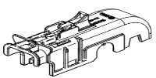

ABS 38W Female connector
Description | PIC | Series | PN | M. Site | Drawing NO.
Female connector housing |  | Lever left, Wire right | 13579681(Code 0) | China | 15498537_CUS01_S01.pdf
 |  |  | 13863402(Code 1) | China | 13653053_CUS01_S01.pdf
 |  |  | 13670757(Code 2) | China | 15498537_CUS01_S01.pdf
 |  |  | 15498536(Code 3) | China | 15498537_CUS01_S01.pdf
 |  | Lever right, Wire left | 13653052(code 0) | China | 13653053_CUS01_S01.pdf
 |  |  | 13598001(code 1) | China | 13653053_CUS01_S01.pdf
 |  |  | 13598002(code 2) | China | 13653053_CUS01_S01.pdf
Cover |  | Horizontal(with no CPA) | 13598000 | China | 13598000_CUS01_S01.tiff
 |  | Horizontal(with CPA) | 13653051 | China | 13653051_CUS01_S01.tiff
 |  | Vertical(no CPA) | 15498543 | EU | 15498544_CUS54_S01.tiff

Slide 4
ABS 38W Female connector
Title | Terminal PN | M. Site | Plating | Drawing NO. | Wire Size Range(mm2) | Cable Seal PN | M. Site | Drawing NO. | Cavity Plug PN | M. Site | Drawing NO.
Female Terminal CTS 150 | 15432208 | China | Sn | 15432214_CUS02_S01.tiff | 0.35mm2 | 15327913(1.2mm-1.6mm) | China | 15446589_CUS53_S01.tiff | 12198198 | EU | 13661690_CUS51_S01.pdf
 | 15432210 | China | Sn |  | 0.5-0.75mm2 | 15327918(1.2-2.0mm) | China
 | 15432212 | China | Sn |  | 1-1.5mm2 | 15339412( 1.9-2.1mm ) | EU
Female Terminal CTS 280 | 15446673 | EU | Sn | 15446676_CUS02_S01.pdf | 0.35mm2 | 15327860(1.2-2.0mm) | Korea |  | 15337197 | EU | 13688485_CUS51_S01.pdf
 | 15446674 | EU | Sn |  | 0.5-1mm2 | 15327863(2.0-2.7mm) | EU
 | 15446675 | EU | Sn |  | 1.5-2.5mm2 | 15327859(2.7-3.0mm) | EU
Female Terminal CTS 480 | 13976114 | EU | Sn | 13976112_CUS01_S01.pdf | 0.35mm2 | 15363779(1.2-2.0mm) | EU |  | 12066082 | NA | 12124630_CUS01_S01.pdf
 | 13976115 | EU | Sn |  | 0.5-1.0mm2
 | 13976116 | EU | Sn |  | 1.5-2.5mm2 | 15363604(2.0-2.7mm) | EU
 | 13976117 | EU | Sn |  | 2.5-4mm2 | 15327864(2.8-3.8mm) | EU
 | 13976118 | EU | Sn |  | 4-6mm2 | 15363605(4.0-4.5mm) | EU

